Slide 1
BCOG 100
Logic Lecture 1: What is Logic?

Slide 2
Reading Check Question 3-1
Password: validity
Consider the following argument:
If the the sky is red, then I have blue hair.
The sky is red.
Therefore, I have blue hair.
Is this a valid argument? Why or why not?

Slide 3
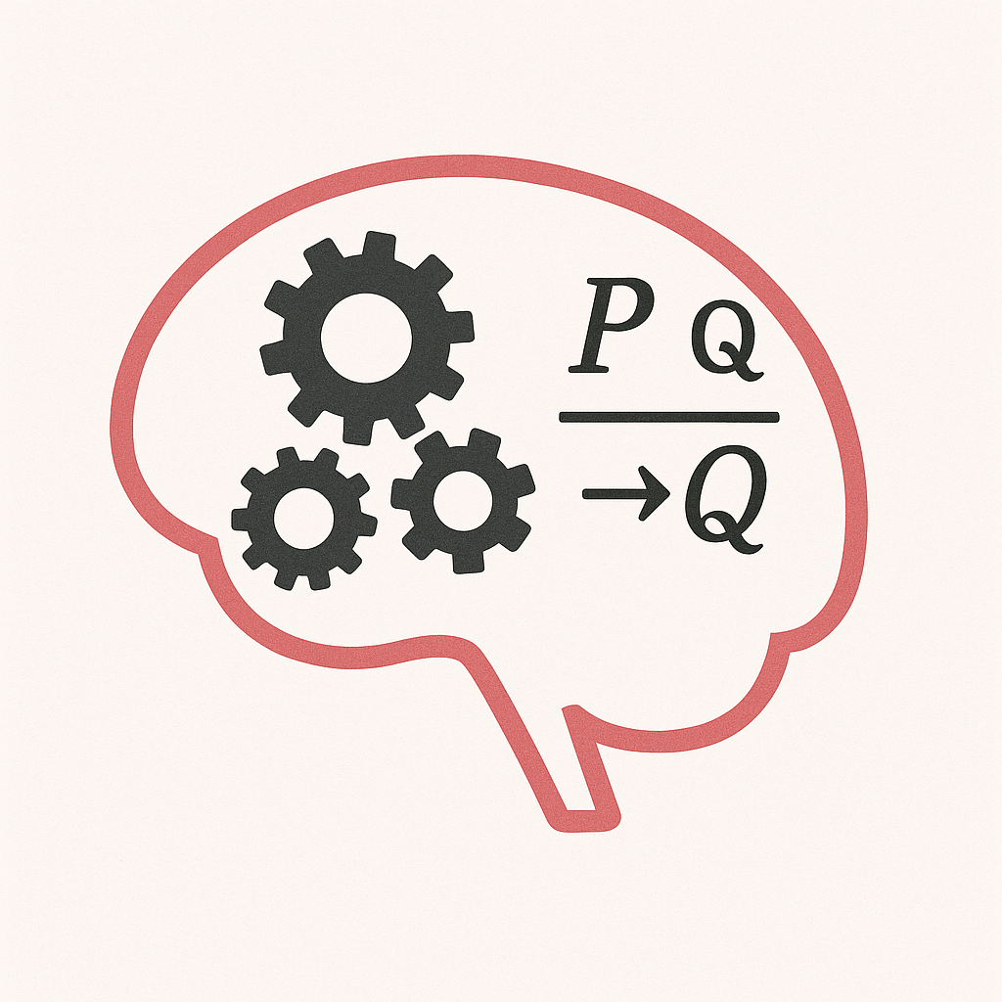
Logic and Brain and Cognitive Science
Why Logic Matters for Cognitive Science
Logic is a formal model of reasoning.
Cognitive science asks: Do humans think logically? If not, how do we differ?
Studying logic gives us a baseline for comparing ideal reasoning vs. real reasoning.
Logic as a Bridge Between Philosophy and Psychology
Philosophy: Defines the principles of valid reasoning.
Psychology: Studies how people actually reason (often fallibly).
Cognitive science connects the two: Where do humans approximate logic, and where do they deviate?

Slide 4
Logic and Brain and Cognitive Science
Logic and Everyday Cognitive Tasks
Understanding arguments in science, politics, or media depends on spotting logical structure.
Fallacies aren’t just abstract—they explain why people get misled by misinformation.
Being trained in logic = better critical thinking and bias detection.
Logic and Artificial Intelligence
Early AI systems were purely logic-based.
Today’s knowledge graphs, symbolic AI, and reasoning engines rely on logic.
Question: How much of cognition can be captured by logical rules?
Logic and Neuroscience
Neural circuits can be described in logical terms (e.g., AND/OR/NOT gates).
Logic offers a simple way to model computation in the brain.
But: biological brains often use probabilistic or heuristic reasoning instead of strict logic.

Slide 5
Logic and Brain and Cognitive Science
Logic as a Model of Mental Representation
Cognitive scientists ask: What kind of representations does the mind use?
Logic suggests propositions and truth values.
Alternative models: probabilistic reasoning, neural networks, associative systems.
Logic gives a yardstick to evaluate these competing views.
Limits of Logic in Explaining Cognition
Real human reasoning: messy, biased, heuristic.
Cognitive science research (e.g., Wason selection task) shows systematic departures from logic.
Studying these gaps tells us how humans think differently from formal systems.

Slide 6
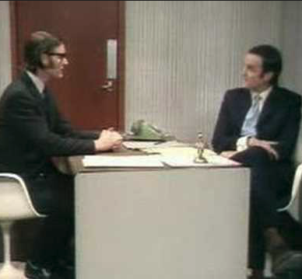
Arguments
Argument: A collection of propositions called premises (P₁, P₂, …P_{N}) put forward by a reasoner (R) providing independent support of a proposition called the conclusion (C)
Arguments come in (at least) two types: deductive & inductive

Slide 7
Arguments
Deductive arguments
that are well-grounded (i.e., has true premises that are clear and well defined) and are valid (i.e., follows the rules of logic) are guaranteed to have a true conclusion.
We call an argument “sound” if it is both valid (well-formed) and grounded.

Slide 8
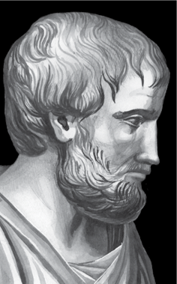
Formal Logic
Formal logic examines what propositions necessarily follow from what other propositions because of their forms, regardless of their content
Propositions: declarative sentences that have a subject and a predicate, the thing that we are asserting about the subject.
All dogs have tails. Fido is a dog. Therefore. Fido has a tail.
All dogs have tails. Max has a tail. Therefore, Max is a dog.
All X’s have F.
x is a n X
Therefore, x has F.
All X’s have F.
x has an F.
Therefore, x is an X.
Aristotle
384-322 BCE
Notes:
We have learned that there are two criteria for acceptable arguments: well-groundedness and validity. You have also seen that there are two types of arguments: inductive and deductive. So far, you have examined some aspects of informal logic—that is, analysis of the well-groundedness of arguments—and you have looked at validity concerns for inductive arguments. What remains is deductive validity, the aspect of logic that has historically commanded a great amount of attention from logicians. In this lecture, you will be introduced to formal logic.

Slide 9
Formal Logic
To evaluate arguments, we need procedures for determining:
groundedness (are the premises true)
validity (is the conclusion necessarily true if the premises are true)
There are many ways we can make both of these kinds of mistakes. Commonly recurring mistakes are called fallacies.

Slide 10

Fallacies
Fallacy: a reasoning error that creates an unsound argument that nonetheless sounds attractive to our mind.
These can affect both the groundedness and the validity (form) of the argument.

Slide 11
Fallacies
Begging the question: any argument where the conclusion is being used in support of itself.
Circular arguments
Leading questions
Taking advantage of assumptions or connotations
Notes:
People often misuse “begging the question” when they mean to say “that leads one to ask the question”. In logic, begging the question specifically means any argument where the conclusion is being used in support of itself and no independent reason is given.

Slide 12
Circular Argument
Fallacies
[1] My name is Jon
∴ [2] My name is Jon
Circular argument: an argument where the conclusion is also one of the premises
Circular arguments are valid (if we assume premise is true, conclusion must be true)
Premise does not provide independent support of the conclusion
Are the following circular arguments?
Murder is wrong because killing people is immoral
Using drugs is bad because drug use is harmful
It is wrong to kill animals because it is wrong to kill anything that can feel pain.

Slide 13
Fallacies
Equivocation
Equivocation: taking advantage of ambiguity to change the meaning of a word within an argument
[1] Tables are furniture
[2] My statistics book has tables in it
∴ [3] There is furniture in my statistics book
[1] We have a right to vote
[2] We should always do what is right
∴ [3] We should always vote

Slide 14
Fallacies
Distinction without a difference
Distinction without difference: when we try to draw a distinction between two things that are not actually distinct.
I didn’t steal it, I just borrowed it.

Slide 15
Appeal to Authority, Common Belief, Tradition
Fallacies
Is appealing to an authority always a fallacy? If so, why are you listening to me?
What makes someone a legitimate authority? Three requirements
The person must exist (No “I heard somewhere that…”)
The person is actually an expert (is in a position to know the answer)
The person must not have a stake in you believing one way or the other
Appeals to common and tradition are like appeals to authority:
Is “the crowd” in a better position to know than you?
Are they committing fallacies to believe what they do?
Are they (consciously or not) invested in what you believe?
Often a form of begging the question, not providing independent evidence

Slide 16
Fallacies
Arguing by (Bad) Analogy
Another flawed version of a good form of reasoning
Successful analogies involve structural similarities between two systems. An analogy can go wrong if that structural similarity is missing.
[1] Elon Musk was successful in business
∴ [2] Elon Musk will be a good politician
[1] Elon Musk was successful in business
[2] Being successful in business and politics involve the same skills
∴ [3] Elon Musk will be a good politician

Slide 17
Fallacies
Fallacies of Causation
Post hoc fallacy: Post hoc, ergo proper hoct, After this, therefore because of this
Neglecting of a common cause fallacy
Causal oversimplification: A+B+C+D…→Z != A→Z
Confusion of necessary with sufficient conditions: A→B != B→A
Slippery slope fallacy: A→B→C→D

Slide 18
Fallacies
Fallacies of Irrelevance
Ad hominem: “to the man”. Don’t listen to him/her, they are an X.
Tu Quoque: “but you do it too”
Don’t trust him, it’s in his interest for you to believe them
Attacking a Straw Man: violating the principle of charity (i.e., assess the strongest possible version of an argument).
Arguments that alter the score of the premises or conclusion
Arguments that replace premises: “the real reason…"
Red Herring: an argument that replaces an argument’s conclusion
“Abortion restrictions are an affront freedom, to womens’ right to control their own bodies”. “Oh, that’s funny, coming from someone who wants to take away everyone’s guns.”

